Slide 1
Non-Ionizing Radiation: Standards and Regulations
Bob Curtis, OSHA Salt Lake Technical Center October 2002

Slide 2
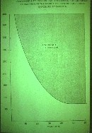
Power Density vs. Time to Generate Cataracts
Threshold @ 40 min
= 100 mW/sq.cm.
Safety factor of 10
= 10 mW/sq.cm.

Slide 3
Applicable OSHA Standards
23 States have their own OSHA Standards
Standards must be at least as strict as Feds
Most copy Federal standards & interpretations
Some require a Safety and Health Program
1910.97 - Non-Ionizing Radiation
10 mW/sq.cm, 6 min. average, 10MHz-100GHz
No spatial averaging
Uses voluntary language of 1966 ANSI
Mandates look of RF Sign

Slide 4
Applicable OSHA Standards (cont.)
1910.268 - Telecommunication Industry
Primarily safety requirements, such as electrical
Mandates 1910.97 compliance for 1-300 GHz
Describes “Tagout” of antenna 3-300 MHz
1926.54, 20 - Construction Industry
Includes tower erection, repairs and painting
Limits MW to 10 mW/sq.cm. (no averaging)
Requires Programs to provide safe work to employees and contractors; includes inspection

Slide 5
OSHA Exposure Standards are Dated
Construction Laser standard does not include Laser Classification and controls
RF Exposure Limit is from 1966 ANSI
Not frequency dependent
Does not address induced current limits
Incomplete on Hazard Communication
Describes RF Sign but not where to use it
One Warning sign for all conditions
Incomplete on RF Safety Program Elements

Slide 6
Applicable OSHA Standards (cont.)
1910.147 - Lockout/Tagout of Power
Requires lockout or tagout of power during maintenance to prevent excessive exposures
1910.132 - Personal Protective Equipment
Requires hazard assessment to select appropriate PPE
Interpretation letter addresses RF Clothing
1910.145, 1926.200 - Signs and Tags
Use signs to warn of hazards

Slide 7
Applicable OSHA Standards (cont.)
1904 - Record Keeping
Log of injuries and illnesses, accidents
1910.1020 - Access to Employee Exposure and Medical Records
1926.20 – Construction Safety Plan
Section 5(a)(1) of OSH Act
Requires a safe and healthful workplace free of recognized serious hazards

Slide 8
Consensus Standards: ACGIH TLVs
Ultraviolet Radiation
Light and Near-Infrared Radiation
Lasers
Radiofrequency/Microwave Radiation
Sub-RF and Static Electric Fields
Sub-RF Magnetic Fields
Static Magnetic Fields

Slide 9
Consensus Standards: ANSI Laser Standards
Z136.1-2000: Safe Use of Lasers
Z136.5-2000: Safe Use of in Educational Institutions
Z136.6-2000: Safe Use of Lasers in an Outdoor Environment
Z136.3–1996: Safe Use of Lasers in Health Care Facilities
Z136.2-1997: Safe Use of Optical Fiber Communication Systems Utilizing Laser Diode and LED Sources

Slide 10
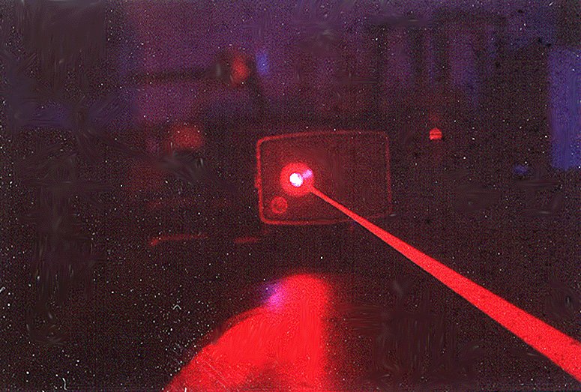
This image is copyrighted.

Slide 11
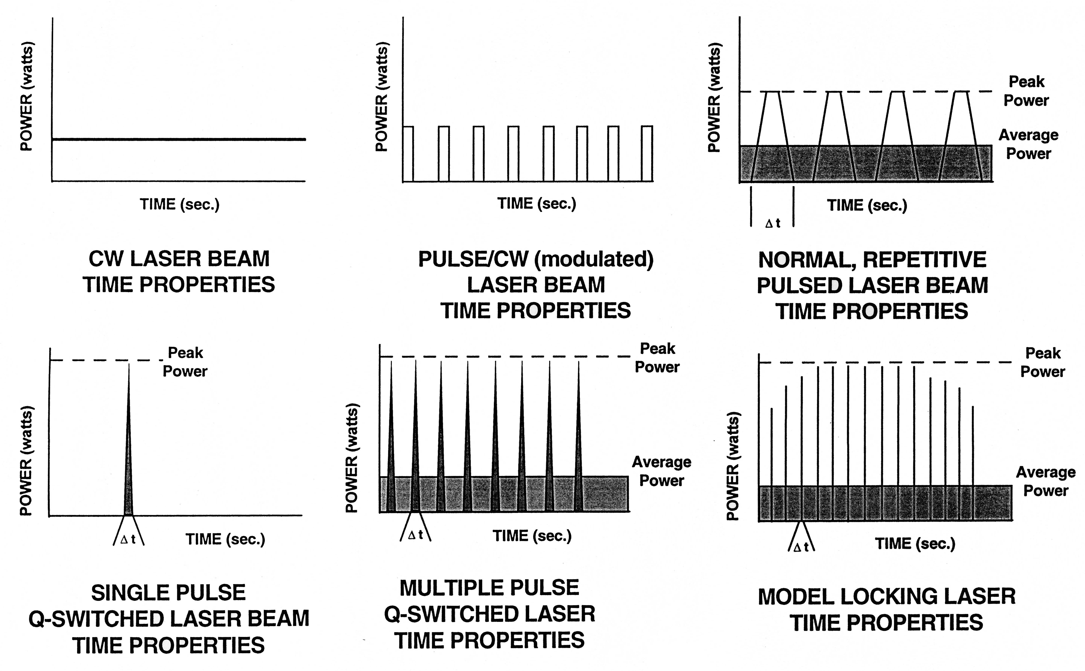
Continuous vs. Pulsed Lasers
Thinner pulses give higher peaks for same average Power.

Slide 12
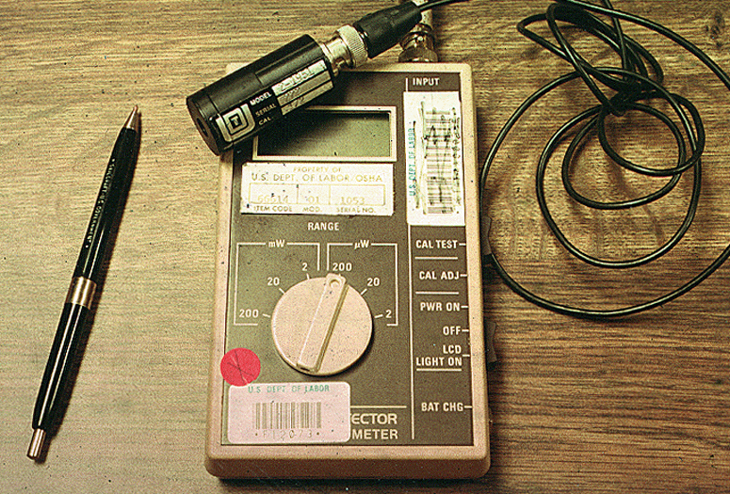

Slide 13
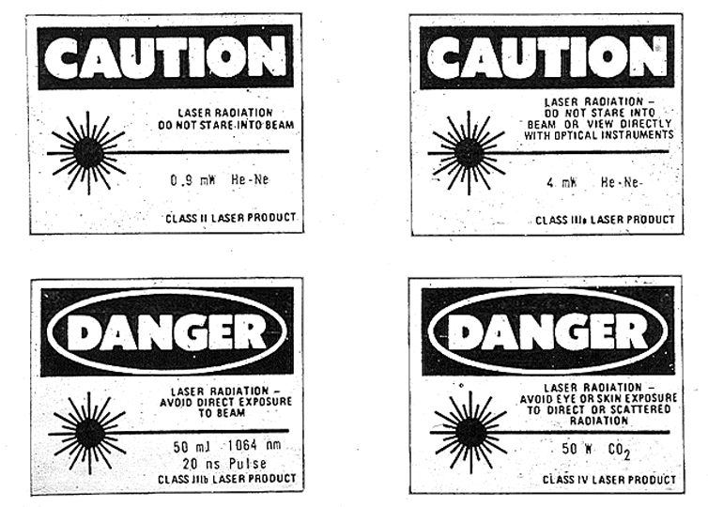

Slide 14
Laser Classes
Class I: Safe – no label needed
Do not disassemble Class I systems
Class II: Visible lasers.
Aversion response provides protection.
Prevent staring into beam
Class IIIa: Visible lasers.
Limit eye exposure from focusing lenses
Class IIIb: No eye exposure
Class IV: No eye or skin exposure.
Hazard from diffuse reflections
Potential fire hazard
Notes:
Class 1 – CD ROM player
Class 2 – Grocery Scanner
Class 3 – Laser pointer

Slide 15
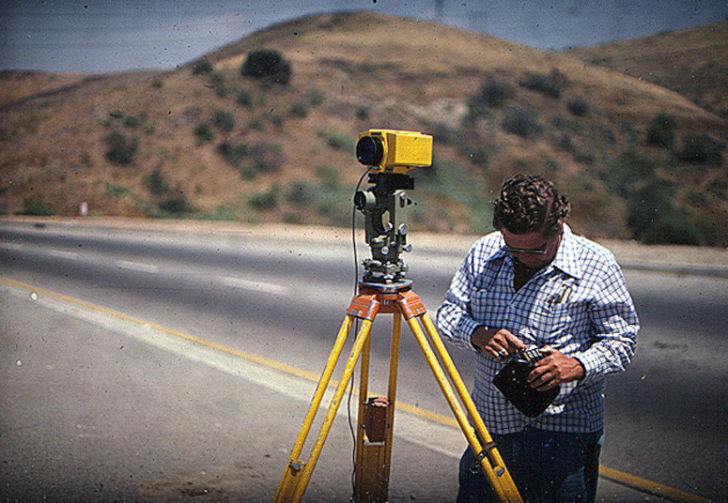

Slide 16
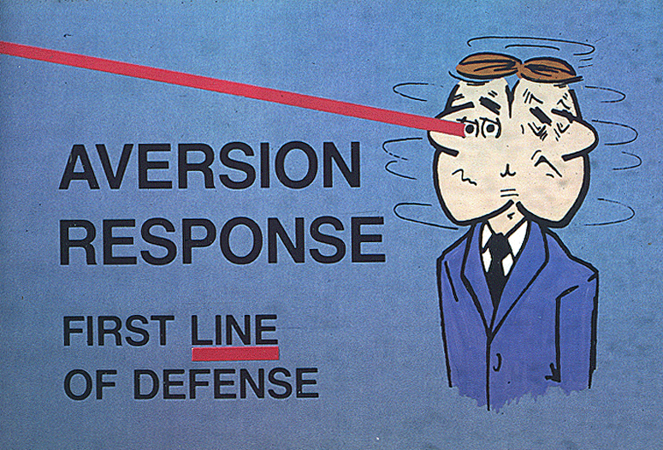
This image is copyrighted.

Slide 17
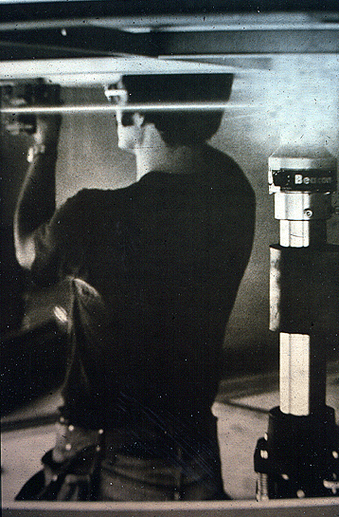

Slide 18
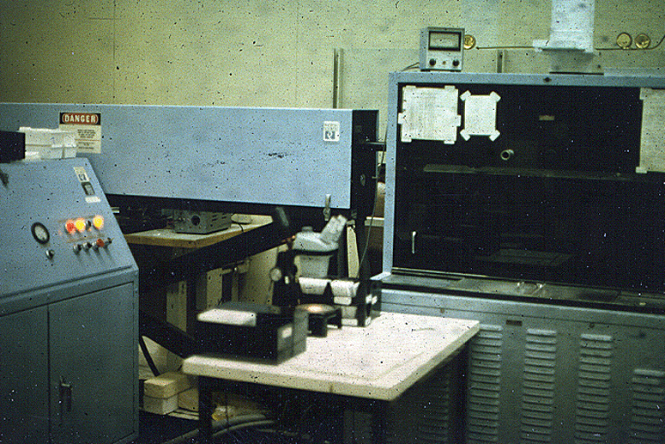

Slide 19
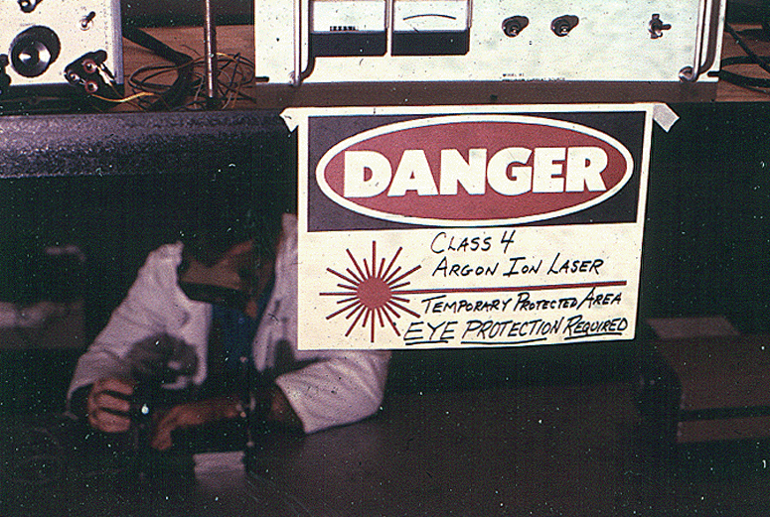

Slide 20
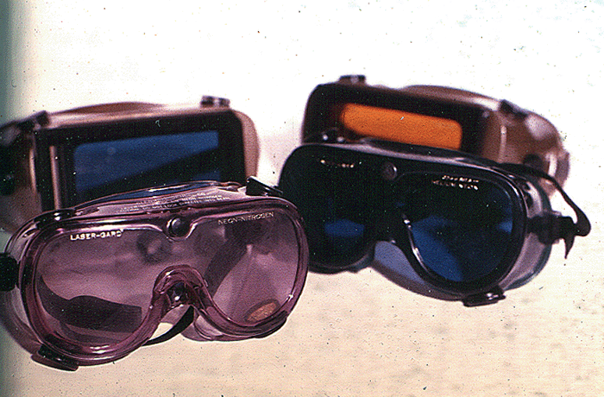
This image is copyrighted.

Slide 21
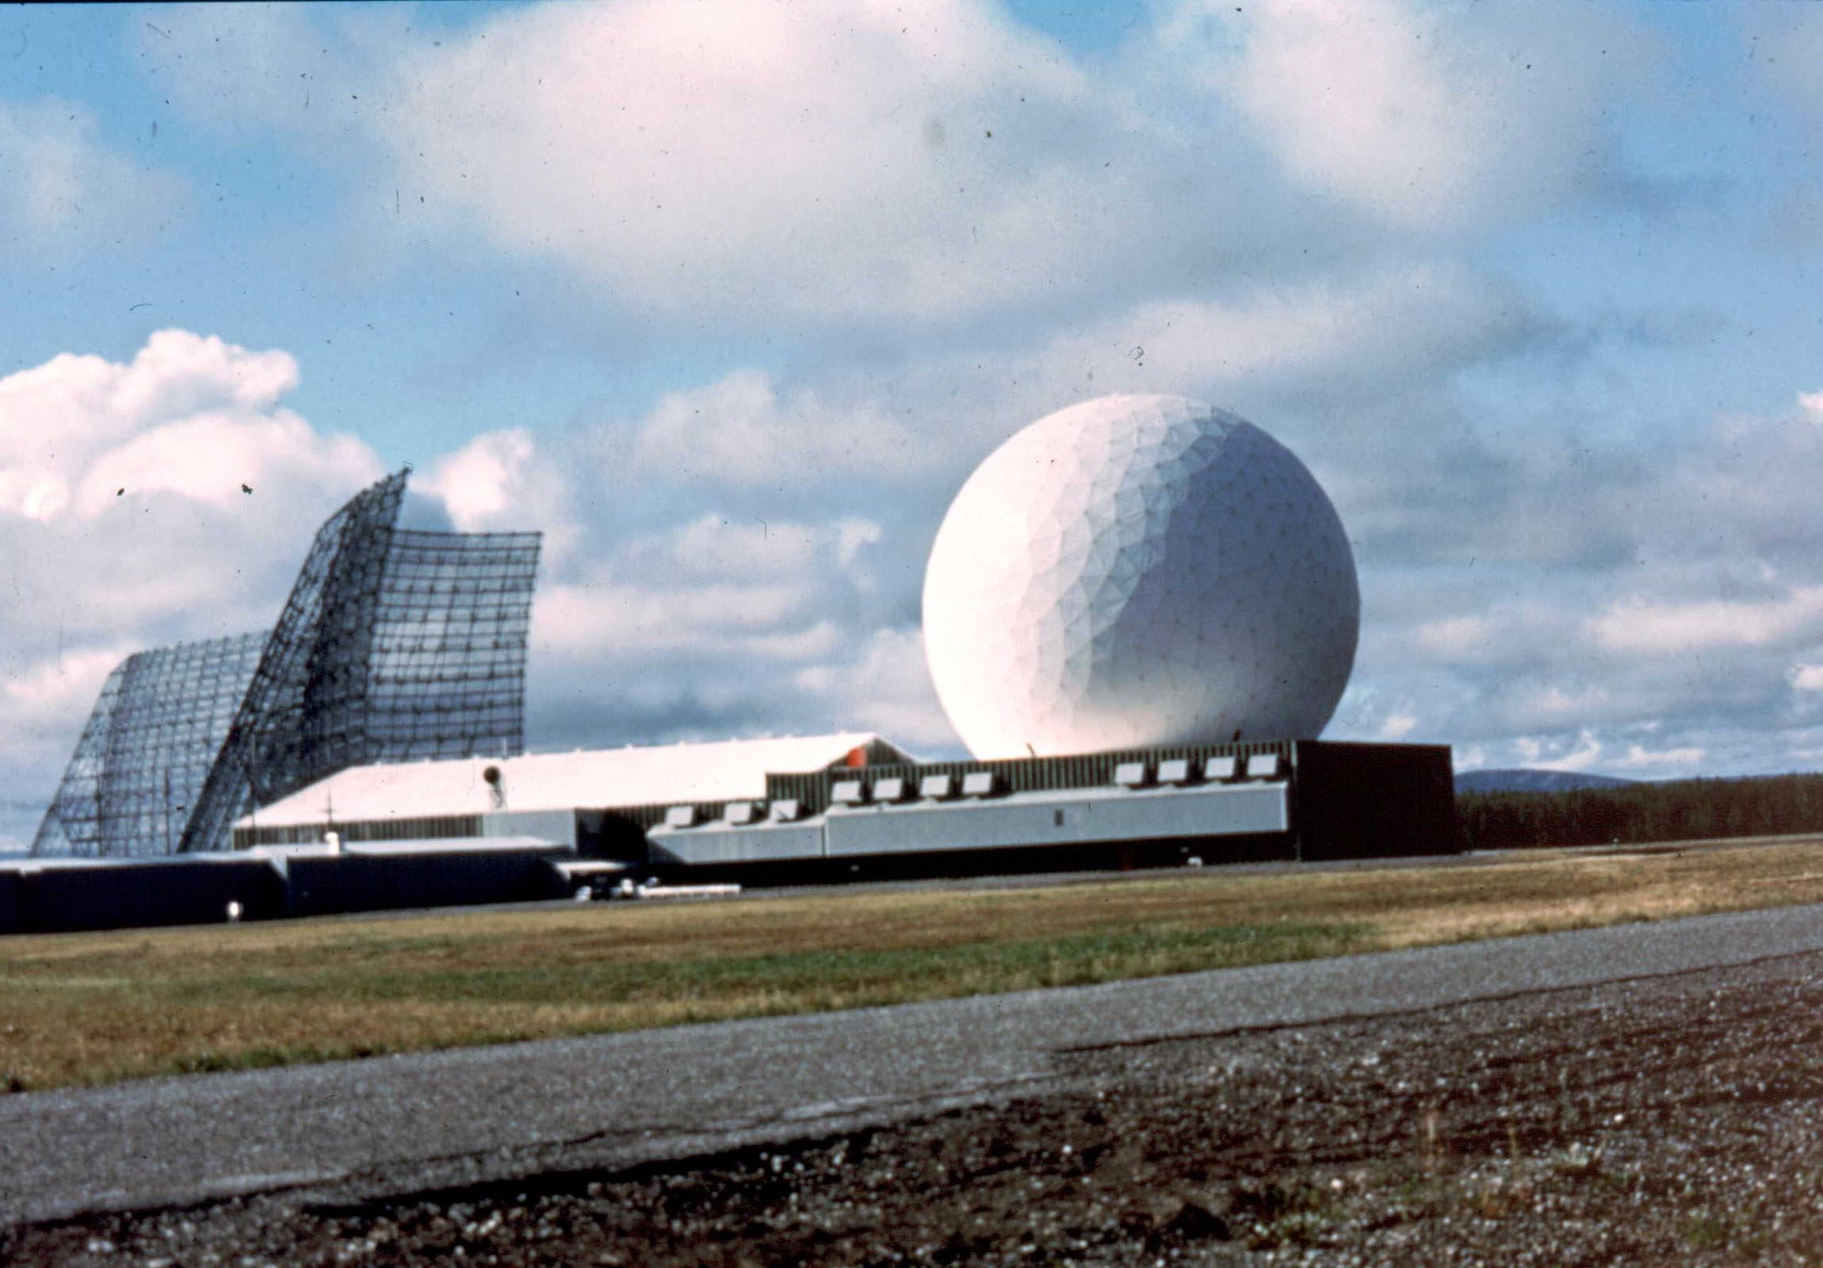

Slide 22
RF Consensus Standards
IEEE/ANSI (U.S.)
C95.1 - RF/MW Exposure limits
C95.2 - Signage and S&H programs
C95.3 – Measurement
Separate ELF standard
ICNIRP (International)
Single standard 1 Hz to 300 GHz
ACGIH TLV’s (US)
RF/MW, Sub-Resonant E & H

Slide 23
Basis of Current RF Standards
Behavioral disruption threshold
Limit temperature increase to 1 degrees C
1-4 W/kg SAR
10-fold safety factor
Notes:
Notes:
4 W/kg based on animal behavioral effects is the basis
Factor of 10 safety factor for whole body in humans (4/10 = .4 W/kg).
Localized maximums of 20 times the whole body average (.4 x 20 = 8 W/kg).
Uncontrolled environments limited to 20% of controlled (8 x .2 = 1.6 W/kg).

Slide 24
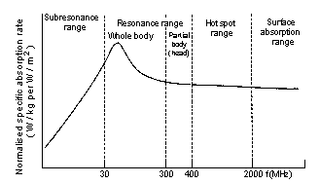
Specific Absorption Rate Absorbed power in Watts/kg
SAR vs. Frequency
Notes:
Notes: Rfmw standards are based on frequency ranges and resonance
Subresonant (<3 MHz) - Body and parts do not function as good antennas. Current flow considerations dominant throughout.
Resonant (3 MHz - 6 GHz) - Body becomes good antenna which maximized absorption.
Current flow and SAR (dose) both important considerations (current flow greater than or equal to 100 MHz). Absorption falls of in proportion to square of frequency from 3 - 30 MHz.
Standards most stringent from 30 - 300 MHz.
In transition to next region (from 300 MHz - 3 GHz) adsorption drops off linearly as frequency increases.
Superesonant (6 GHz - 300 GHz) - Body no longer acts as good antenna, absorption at ~ 1/10 peak absorption. Quasi-optical focusing from 6 - 15 GHz. Skin absorption dominant > 15 GHz (penetration < 1 cm).

Slide 25
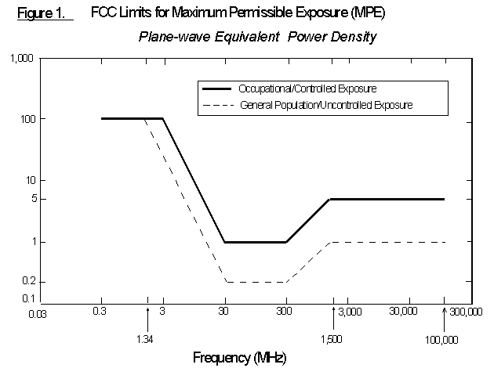

Slide 26
RF Exposure Standards are Typically Based on 6 min. TWA
Excursions allowed if 6 min time weighted average is within limits
Up to 30 min intervals used for public exposure standards
Notes:
Notes: The time-averaging concept can be illustrated as follows. The sum of the product (or products) of the actual exposure level(s) times the actual times(s) of exposure must not be greater then the allowed (average) exposure limit times the specified averaging time. This means that, at 100 MHz, exposure at 2 mW/cm² would be permitted for 3 minutes in any 6-minute period as long as during the remaining 3 minutes of the 6-minute period the exposure was at or near "zero" level of exposure. Similarly, during any 6-minute period, exposure at 1.5 mW/cm² would be allowed for 4 total minutes if exposures during the remaining 2 minutes were zero. Another example, 1.5 mW/cm² would be allowed for 3 minutes and 0.5 mW/cm² would be allowed for the remaining 3 minutes of a 6-minute period. Therefore, in the first example:
(2 mW/cm²) X (3 min.) + (0 mW/cm²) X (3 min.) = (1 mW/cm²) X (6 min.)
In the second example:
(1.5 mW/cm²) X (4 min.) + (0 mW/cm²) X (3 min.) = (1 mW/cm²) X (6 min.)
And, in the third example:
(1.5 mW/cm²) X (3 min.) + (0.5 mW/cm²) X (3 min.) = (1 mW/cm²) X (6 min.)

Slide 27
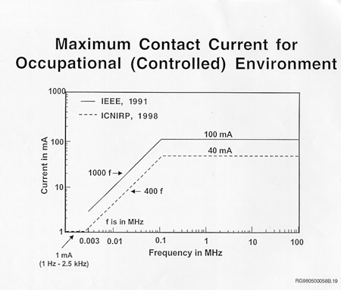

Slide 28
Use of ANSI vs. OSHA vs. FCC Standards
Newer, more restrictive standards can be used.
Meeting SAR limits is often easier than field limits.
New standards allow for spatial averaging, but you have to adopt the whole package.

Slide 29
Use of ANSI vs. OSHA vs. FCC Standards (cont.)
Convenient to adopt FCC (with RF current limits).
OSHA state programs may dictate, but usually defer to newer standards.

Slide 30
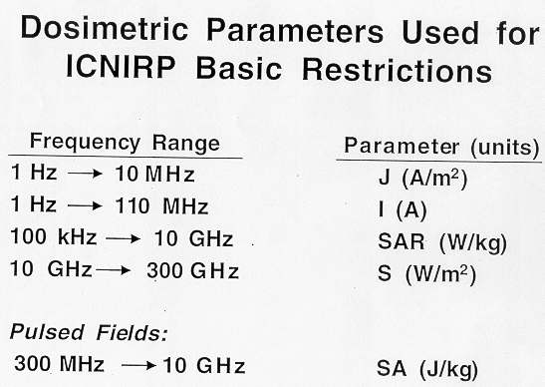

Slide 31
Same Basis, but Standards Differ
General population vs. Controlled RF Sites
Localized exposure limits (spatial averaging)
Time averaging
Special exclusions, such as low-power devices, peak exposures.
Notes:
Notes:
OSHA uses lower tier as an "action level", e.g., an RF program should exist.
ANSI assumes 0.4 W/kg is safe for all
NRPB says 2-tier is not needed.
ICNIRP justifies lower tier for thermally sensitive, elderly, children, neonates.

Slide 32
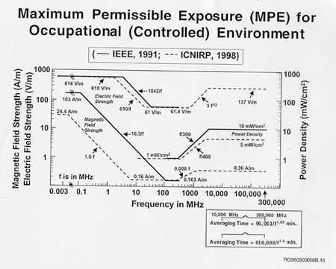

Slide 33
Safety & Health Programs
OSHA promotes implementing an effective Safety & Health Program
Many State OSHA’s Already Require
Required for Federal Agencies
Required by International Standards (ISO)
Good Employers will Implement Regardless of OSHA

Slide 34
What is Needed? Site-Specific RF Program
Work site Safety and Health Programs should include an RF Program if significant exposures are possible.
A priority, because S&H Programs can be very effective in preventing excessive exposures.

Slide 35
Basic Requirements
Implement an RF program where exposures exceed FCC “General Population” or Public limits (see following slides).
The RF Program must ensure employee exposure does not exceed FCC “Occupational” limits.

Slide 36
Hazcom Program should exist for “Uncommonly High” Fields, such as: >50 mG whole body ELF >Uncontrolled limits of FCC

Slide 37
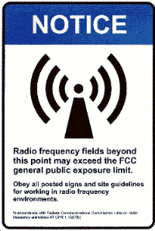
Perimeter of FCC Uncontrolled Limits

Slide 38
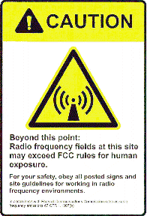
Perimeter of Controlled Limits indicating need for protective measures (e.g., time averaging)

Slide 39
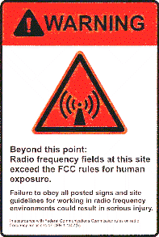
Time averaging is not feasible to prevent exposures > MPE’s

Slide 40
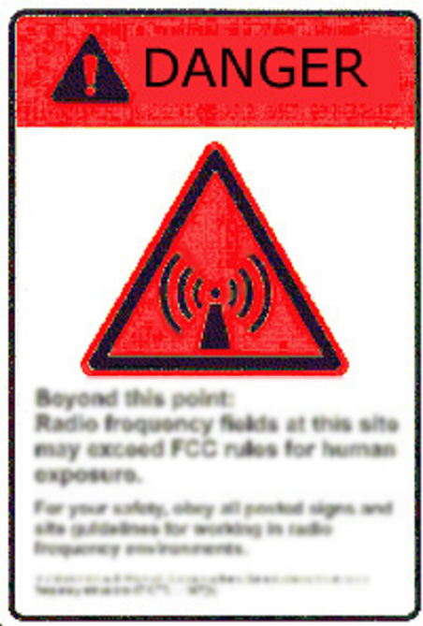
Posted to mark prohibited access without power-down.
PPE is not sufficient.

Slide 41
New Developments Confound Consensus Building
ICNIRP Standard being adopted more
Precautionary Principle being adopted by some countries and local governments.
Regulations regarding Mobile phones & Cellular Tower Sites

Slide 42
Comprehensive Standard vs. Exposure Limit
Combination of practices and exposure limits gives more guidance (e.g. ANSI Laser Stds.)
Exposure limit can be less restrictive.
E.g. Protection for all persons vs. exclusions for target populations.
For each exclusion, you need a program that checks the criteria.

Slide 43
Predictions
Balloting next year on new limit.
Consensus will drive the standard to be similar to existing version.
US will continue to drift apart from other countries which will adopt precautionary principle.
The use of cell phones will continue to rise dramatically.
Other needed RF standards will proceed, but slow in development.

Slide 44
Slow Progress on Needed Standards
RF Safety Program
RF Awareness (Signs)
Medical Surveillance and Response
Measurement Procedures for induced currents
Criteria for RF Protective Clothing
Spark Discharge
Cellular Phones

Slide 45
Extent of RF Program is Based on Exposure
Locations are Categorized (I-V) based on potential exposures.
Many RF exposure situations require no, or a limited RF Safety Program. (Categories I-II)
More extensive program elements for higher exposure categories.

Slide 46
Controls/Administrative (cont.)
I II III IV V
Personal Monitors | NN | No | Opt. | Opt. | No
Incident Response | NN | Yes | Yes | Yes | Yes
Medical Devices & Implants | Personal Respon-sibilty | Personal Respon-sibility | Yes, make aware | Yes | Yes
Maintenance of Controls | NN | Yes for Public | NN for work. | Yes | Yes

Slide 47
Proposed Thresholds
A - Adverse Effect
B - Effect Preliminary to a Known Adverse Effect
C - Effect, but Unknown Human Health Consequence
X - Known Non-Adverse Effect
Notes:
Per NIEHS (1999), “ELF-EMF exposure cannot be recognized as entirely safe because of weak scientific evidence that exposure may pose a leukemia hazard; the associations reported for childhood leukemia and adult chronic lymphocytic leukemia cannot be dismissed easily as random or negative findings.”

Slide 48
For More Information www.osha.gov
Subject Pages on
Lasers
RF/Microwave
ELF
Includes PowerPoints and Lecture Outlines

Slide 49
Miscellaneous Slides: Setting Standards

Slide 50
RF Standard Development
ANSI C95.1-1966 (OSHA Adopted)
ANSI 1982 (Frequency dependent)
ANSI/IEEE 1992 (Two-Tiered)
IEEE SCC-28 in process.

Slide 51
IEEE “Culture”
Engineers/Biologists - few IH’s
Many representatives of Industry and DoD
Few Public Safety Regulators
Standards Based on Known Adverse Health Effects

Slide 52
Process for Standard Development
Literature Review
Engineering
Animal and Cellular (In Vitro, In Vivo)
Epidemiology
Mechanisms
Risk Assessment
Consensus

Slide 53
Problems
Review process going slow.
Risk Assessment proceeding.
Difficulty in getting consensus on basic concepts for a new standard.

Slide 54
Major Issues to Resolve
Selection of adverse effect level.
Basis for local SAR limit.
Acute vs Chronic exposures.
Time Averaging
Uncertainty Factor
One limit vs Public & Worker limits
Action Limit and RF Program
Notes:
Other issues:
Medical surveillance and emergency response.

Slide 55
Exposures between B and C occur within known gaps in research, so “Precautionary Principle” or ALARA may be appropriate.
Precautionary Principle not justified below C level where most exposures occur.
Notes:
Concern for low-level exposures causing DNA changes.
Current standard based on heating causing behavior changes (animals reduced their activities and/or avoided the exposure areas.

Slide 56
Right to Know
More lenient on threshold if people given choices.

Slide 57
Purpose and Scope of the ICNIRP Guidelines
Develop an internally consistent set of exposure guidelines that cover the nonionizing radiation spectrum from 1 Hz to 300 GHz
The guidelines are intended to provide adequate protection against known adverse impacts on human health resulting from direct and indirect EMF exposure effects.

Slide 58
UK Stewart Commission
Preliminary evidence that (phones) may cause, in some cases, subtle biological effects… (This) does not necessarily mean that health is affected.
Advocates the “Precautionary” approach until more information.
Specifically: Labeling of phones; Reduce children use.
Most points accepted by UK gov’t.

Slide 59
1910.268(p)(2)
Accessible areas associated with microwave communication systems where the electromagnetic radiation level exceeds the radiation protection guide given in § 1910.97 shall be posted as described in that section. The lower half of the warning symbol shall include the following:
Radiation in this area may exceed hazard limitations and special precautions are required. Obtain specific instruction before entering.

Slide 60
1910.268(p)(3)
Protective measures. When an employee works in an area where the electromagnetic radiation exceeds the radiation protection guide, the employer shall institute measures that insure that the employee's exposure is not greater than that permitted by the radiation guide. Such measures shall include, but not be limited to those of an administrative or engineering nature or those involving personal protective equipment.

Slide 61
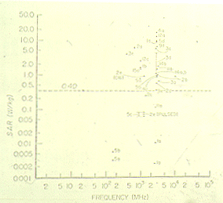
Plot of Frequency vs. SAR of Health Effects

Slide 62
“Modifications” to OSHA Standards
OSHA Directives to Inspectors and Official Interpretation Letters
Acceptance of newer ANSI RF Sign
ANSI Laser Standard Recommended in lieu of outdated OSHA standard.
Guidance for using RF PPE
Education of Employers, Employees, and Compliance Staff

Slide 63
General Duty Clause Criteria
At Least One Employee Exposed
It is a Recognized Serious Hazard
There Are Feasible Means to Correct
The Employer Knew (Or should have known with reasonable diligence)
Rely heavily on Consensus Standards
Even if it Conflict with Existing Standards

Slide 64
Establishing Employer Knowledge and Feasible Controls
Common Industry Practice
Consensus Standards
“5(a)(1) Letter” to Employers
Usually based on Consensus Standards
e.g., ANSI, TLV’s

Slide 65
Basis for the Safety Factor
Thermally stressful environments
Use of alcohol, some medications etc.
Thermally sensitive
Normal factor for Public safety due to unknowns in science, health effects, etc.

Slide 66
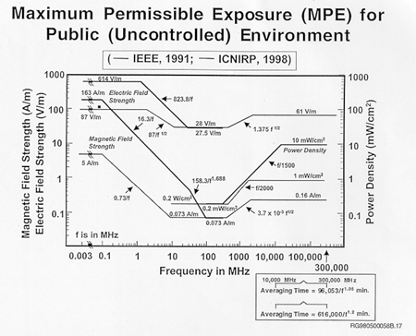

Slide 67
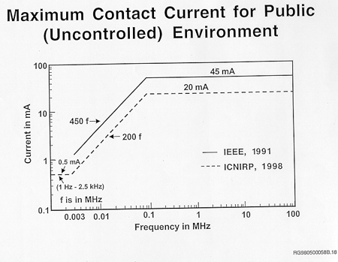

Slide 68
IEEE Gives Guidance about Pulsed RFMW
Pulsed limit = IEEE cw limit x IEEE averaging time (in secs) 5 x pulse duration (in secs)
Peak E field < 100 kV/m
Cw limits apply to situation in which there are more than five pulses during the averaging time

Slide 69
IEEE Gives Guidance about Pulsed RFMW (cont.)
Pulsed mw creates mini shock waves which radar operators have reported as clicking sound: may be responsible for eye and neuropharmacological effects reported for pulsed mw according to Lin

Slide 70
Changes to C95.4-1992 (Supplements)
Induced current measurements are not necessary for frequencies < 450 kHz (controlled) and < 200 kHz (uncontrolled), or if field strengths are low (e.g., 16% at 27 MHz).
Changes to the averaging time for RF currents, including prohibition of RF burns.
Definition of Spatial Average
Notes:
Notes:
Plotted curve of frequency vs. % of field strength MPE.
Ex., 16% at 2-27 MHz.

Slide 71
Changes to C95.4-1992 (Supplements) (cont.)
Definition of Averaging Volume for Spatial-Peak SAR
Establishes minimum measuring distance of 5 cm.
Defines radiated power.

Slide 72
Spatial Averaging
ANSI standard is confusing regarding partial-body vs. non-uniform exposure.
Exception for testes and eyes (See interpretation).
OSHA standards, based on old ANSI, does not allow for spatial averaging.
Notes:
Notes:
Intended to restrict averaging when a limited part of the body (partial body) is exposed to a high localized field, such as end of a waveguide.

Slide 73
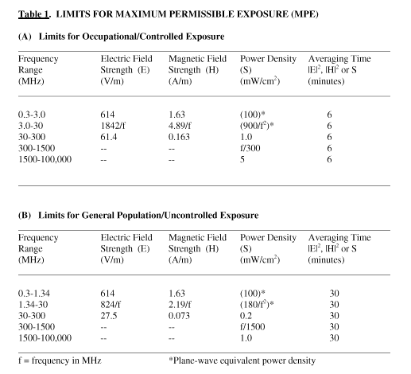

Slide 74
Miscellaneous Slides: RF Exposure Classes

Slide 75
Proposal for ANSI RF Program Standard
Class I areas: No signs needed.
Class II areas: Notice Signs are suggested
Class III areas: Caution Signs are required
Class IV areas: Warning Signs are required
Class V areas: Danger Signs are required

Slide 76
Category I Areas
Locations where RF fields are too weak to cause exposures greater than the FCC general population (public) limits.
No dependence on controls, including time averaging.
NO RF SAFETY PROGRAM NEEDED!!

Slide 77
Category II Areas
Potential exposures are controlled to ensure compliance with FCC Public limits.
Must maintain controls, such as time averaging and shielding, to remain below public limits.

Slide 78
Category III Areas
Locations where RF fields are too weak to cause exposures greater than the FCC Occupational limits.
No dependence on controls, including time averaging.

Slide 79
Category IV Areas
Potential exposures are controlled to ensure compliance with FCC Occupational limits.
Must maintain controls, such as time averaging and shielding, to remain below Occupational limits.

Slide 80
Category V Areas
Exposure conditions which can not be controlled to comply with FCC Occupational limits.
Includes surfaces which will cause serious RF burns if contacted.

Slide 81
Summary Tables of Program Elements Needed for Each Exposure Category

Slide 82
Administrative
I II III IV V
Policy | NN | Yes | Yes | Yes | Yes
Accountable Person | NN | Yes | Yes | Yes | Yes
Documentation | NN | Yes, for incidents | Yes | Yes | Yes
Employee Involvement | NN | No | Opt. | Yes | Yes
RF Safety Committee | NN | No | Opt. | Opt. | Opt.
Procurement of RF Source Equipment | NN | Yes | Yes | Yes | Yes

Slide 83
Identification of Potential Hazards
I II III IV V
Inventory of RF Sources | NN | Yes | Yes | Yes | Yes
Exposure Assessment | NN | Initial, + after change | Initial, + after change | Yes | Yes

Slide 84
Controls/Engineering
I II III IV V
Utilize low exposure Equip. & Site Configuration | NN | Yes | Yes | Yes | Yes
Access Restriction | NN | Opt. | Opt. | Opt. | Yes
Maintenance of Controls | NN | Yes | Yes | Yes | Yes

Slide 85
Controls/Administrative
I II III IV V
Use of Signs | NN | Yes | Yes | Yes | Yes
Access Restriction | NN | Opt. | NN | Opt. | Yes
Work Practices | NN | No | Opt. | Opt. | Opt.
Control of Source Power (LOTO) | NN | No | No | Opt. | Opt.

Slide 86
Controls/Administrative (cont.)
I II III IV V
Personal Monitors | NN | No | Opt. | Opt. | No
Incident Response | NN | Yes | Yes | Yes | Yes
Medical Devices & Implants | Personal Respon-sibilty | Personal Respon-sibility | Yes, make aware | Yes | Yes
Maintenance of Controls | NN | Yes for Public | NN for work. | Yes | Yes

Slide 87
Personal Protective Equipment
I II III IV V
Selection of PPE | NN | No | No | Opt. | When used
Maintenance, Use, & Accessibility | NN | No | No | When used | When used

Slide 88
Training
I II III IV V
Explanation for RF Exposure Limits | NN | NN | Yes | Yes | Yes
Use & Maintenance of Controls | NN | Yes, for RFSO | Yes | Yes | Yes
Recognizing Abnormal Conditions | NN | Yes, for RFSO | Yes | Yes | Yes
Sources of Additional Information | NN | Yes, for RFSO | Yes | Yes | Yes

Slide 89
Program Review
I II III IV V
Adequacy of Present Program Design | NN | Yes | Yes | Yes | Yes
Implementation (Program in use?) | NN | Yes | Yes | Yes | Yes

Slide 90
Examples of the RF Safety Program Elements

Slide 91
Core Program Elements
Administrative
Identification of Potential Hazards
Controls
Engineering
Administrative
Personal Protective Equipment
Training
Program Review

Slide 92
Administrative
Policy
Management Commitment
Authority to enforce rules
Accountable Persons
Assignment of Duties
Documentation
Employee Involvement
RF Safety Committee
Procurement of RF Source Equipment

Slide 93
Identification of Potential Hazards
Inventory of RF Sources
Exposure Assessment
To establish exposure categories.
To ensure controls are functioning.

Slide 94
Hazard Assessment Options
Direct Measurement
Indirect “Measurement” by comparing to similar sites.
Model calculations

Slide 95
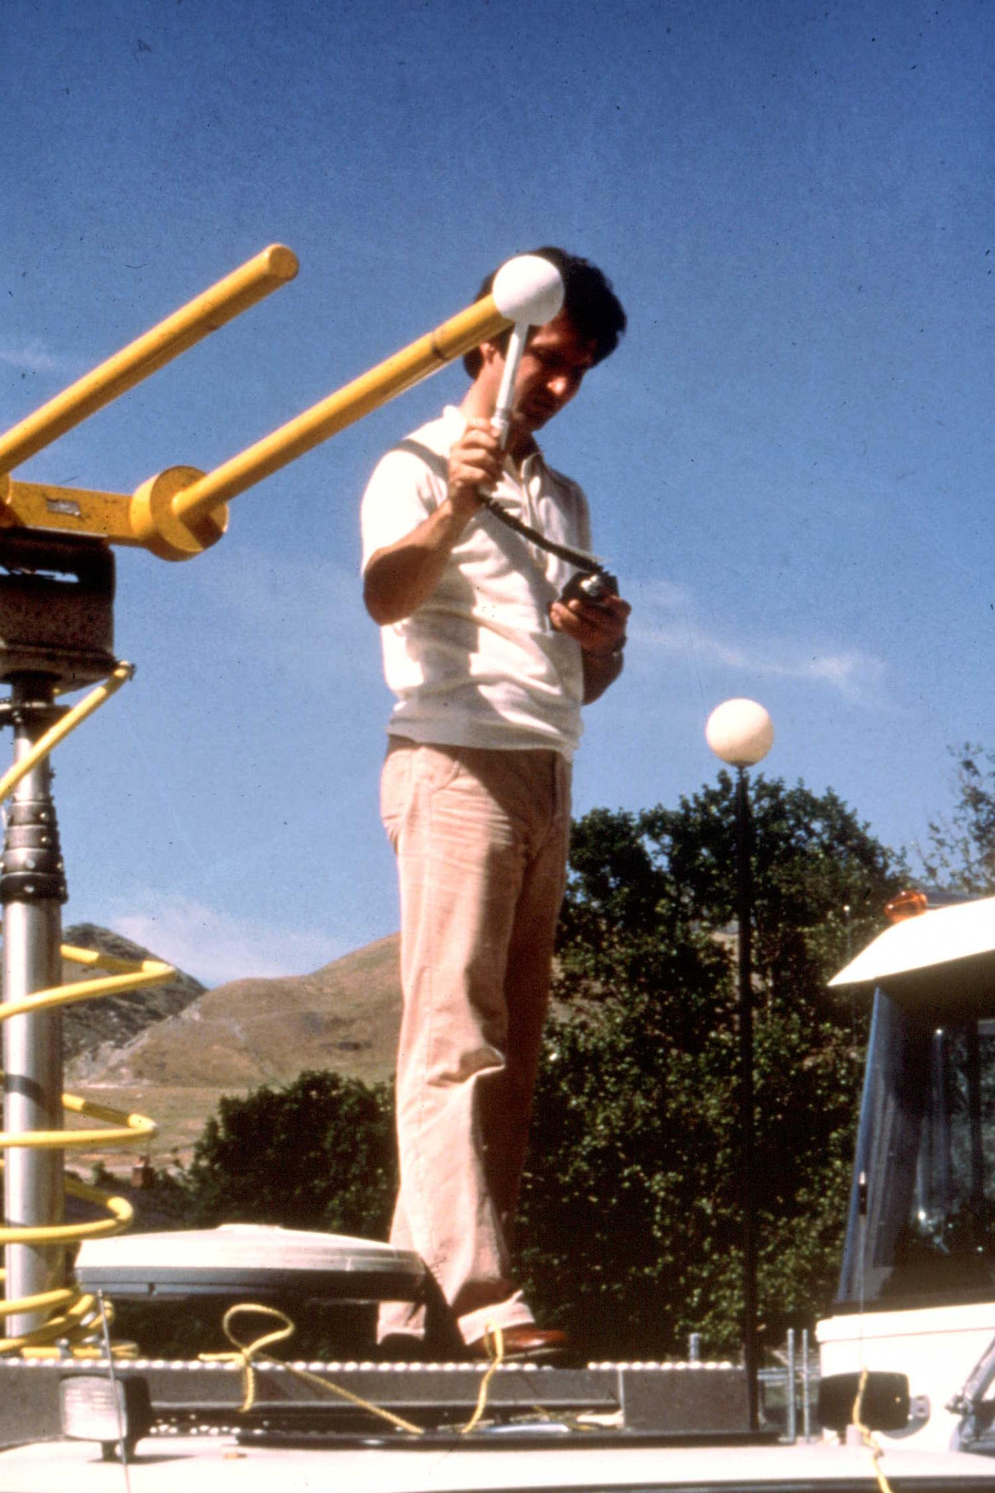
Direct Measurement

Slide 96
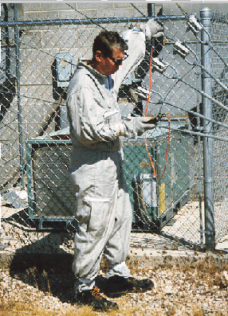
PPE and Direct Measurement
From Ric Tell

Slide 97
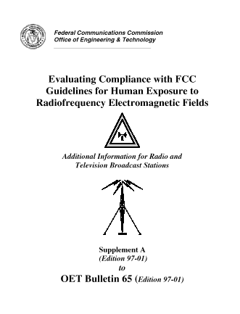
Assess by
modeling.

Slide 98
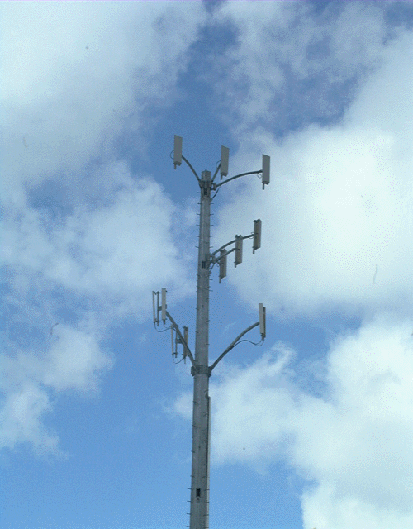
Assess by
comparison.
For example,
cellulars
are well
characterized.
(See examples
at end)

Slide 99
Controls/Engineering
Utilize low exposure equipment & site configuration
Use good equipment
Control hazard areas
Limit exposures
Access Restriction
Maintenance of Controls

Slide 100
Controls/Administrative
Use of Signs
Access Restriction
Work Practices
Control of Power Source (LOTO)
Personal Monitors
Incident Response
Medical Devices and Implants
Maintenance of Controls

Slide 101
Slides of Example Controls
Lockout/Tagout
Personal alarm
Prevent access to hazardous locations (Signs & Fences)
Administrative control program
Protective clothing

Slide 102
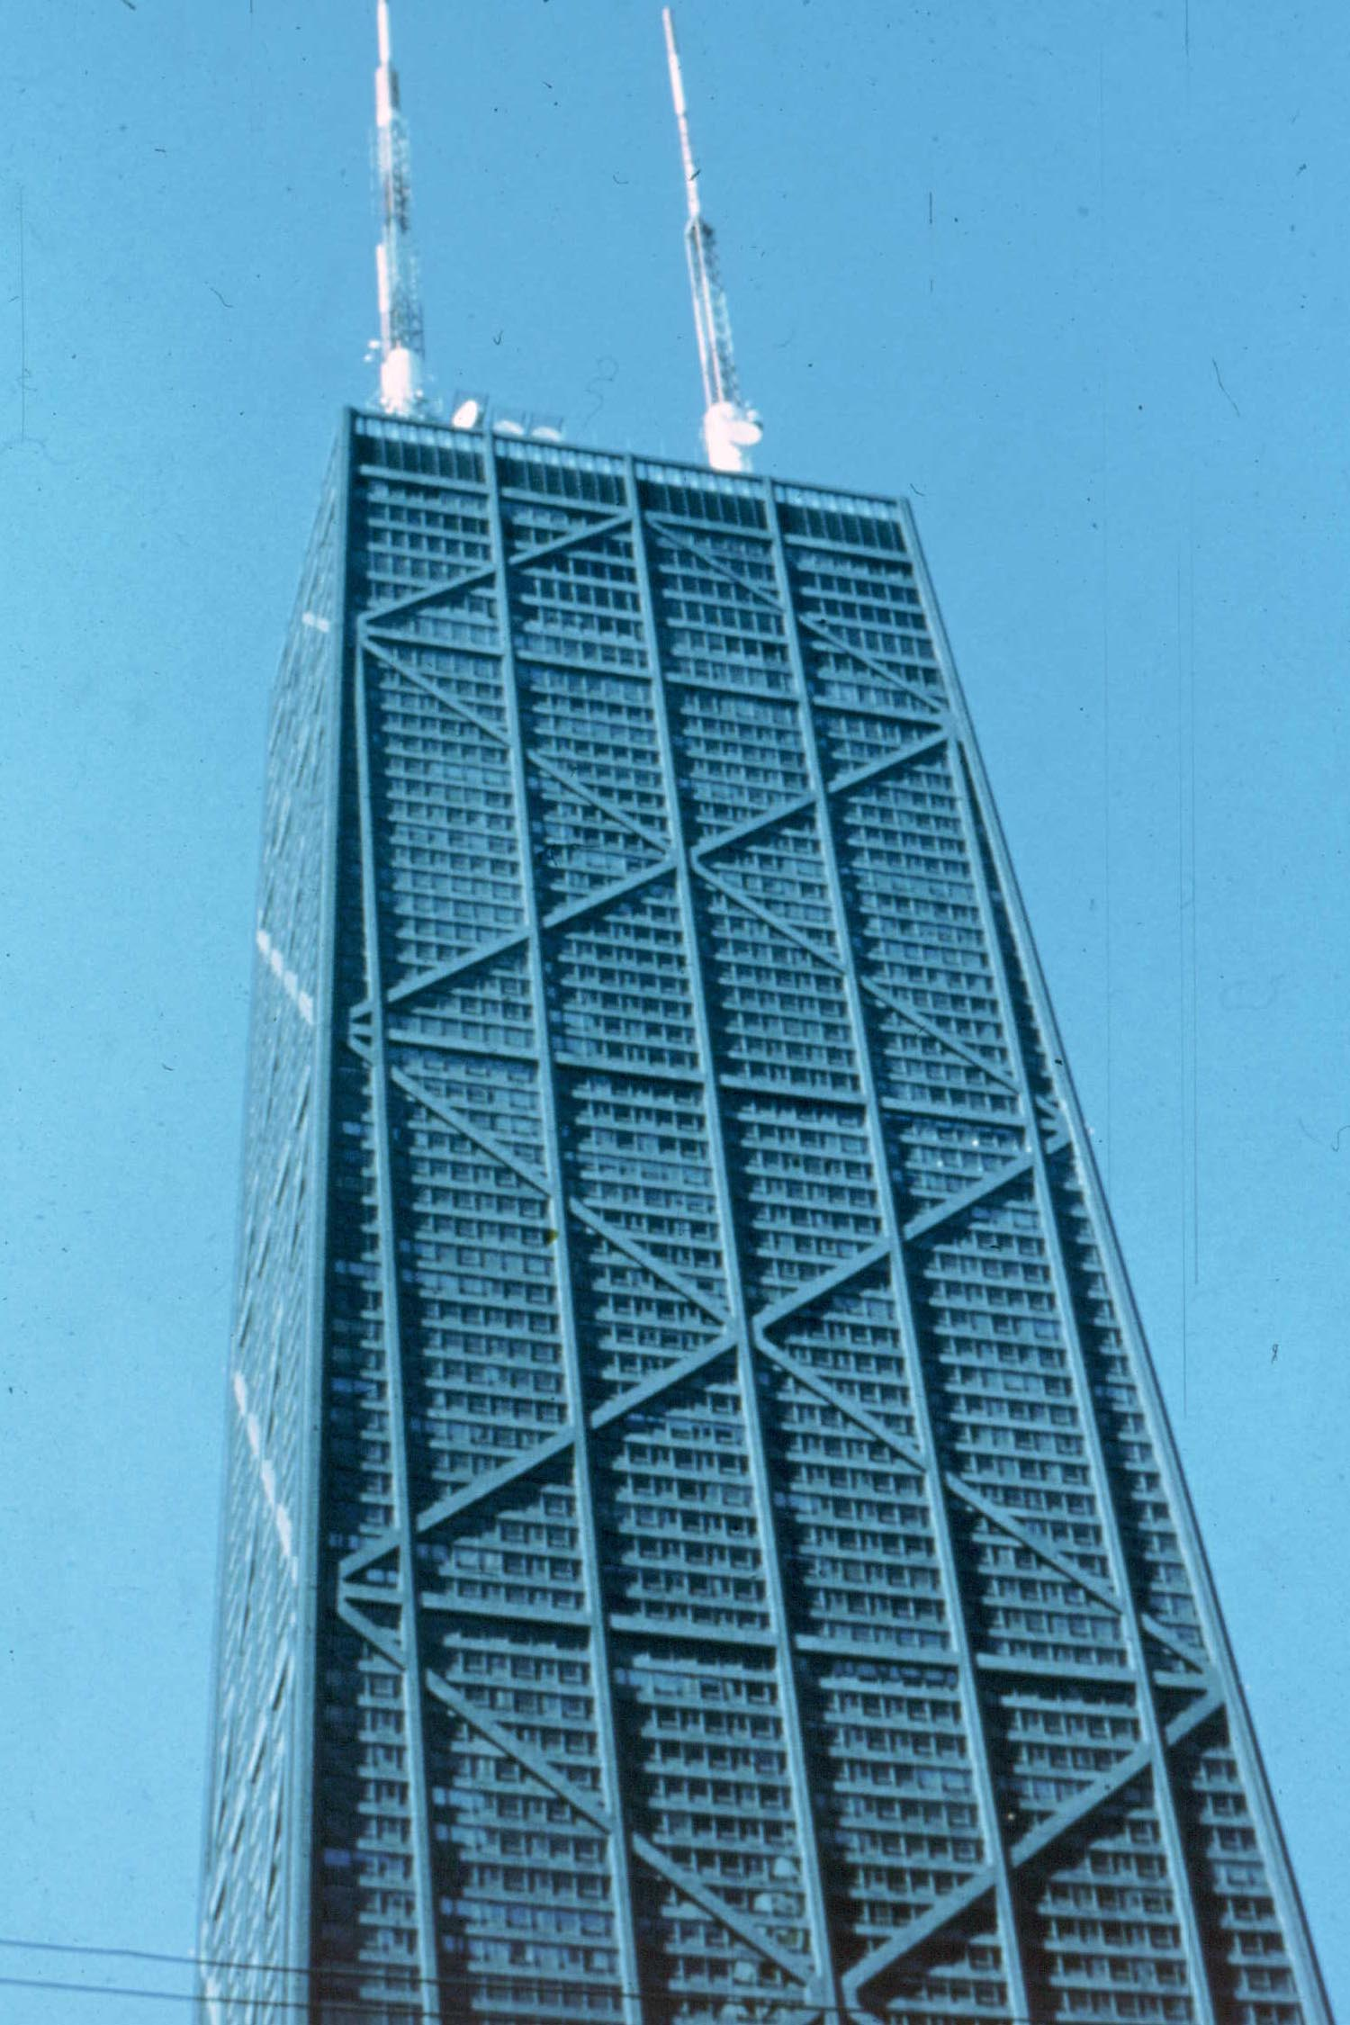
Lock Out / Tag Out

Slide 103
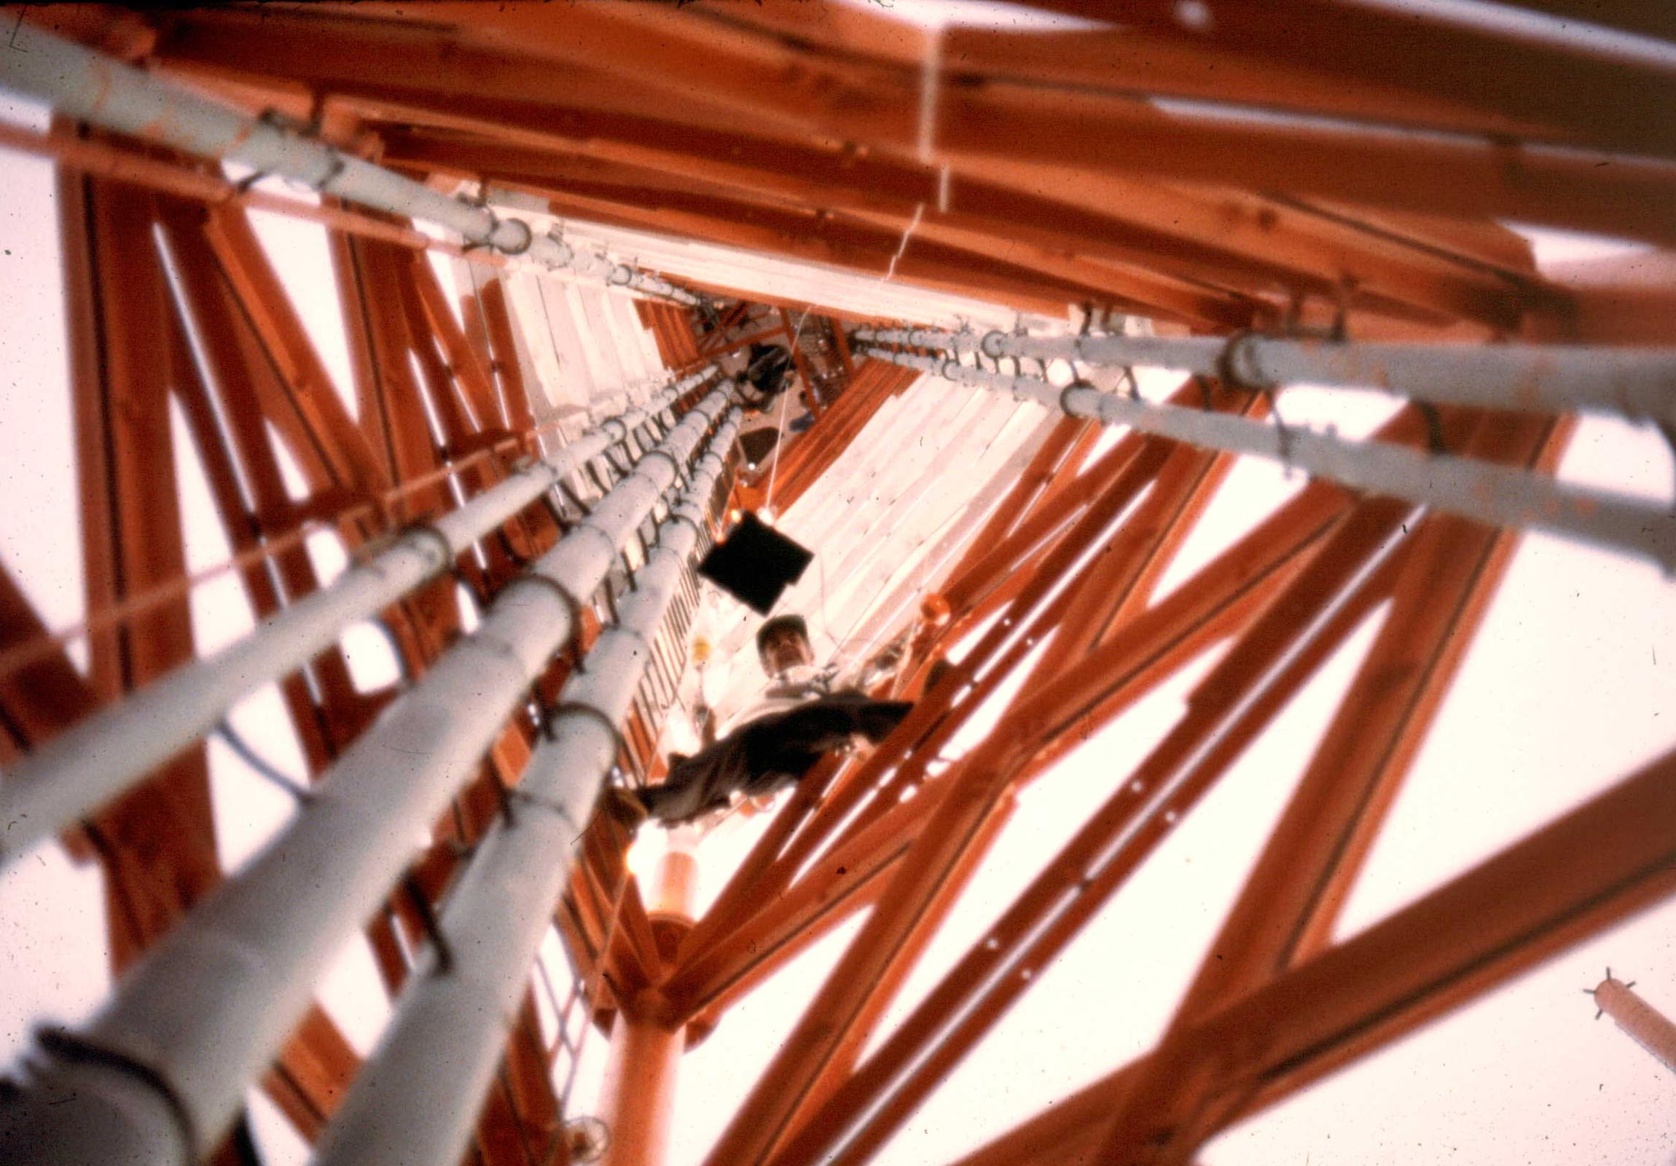
Lock Out / Tag Out Offers Protection for Workers on Tower

Slide 104
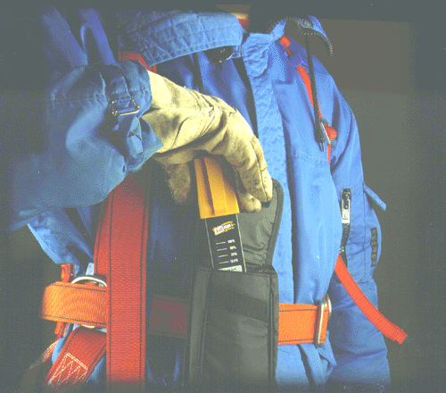
Personal Alarm

Slide 105
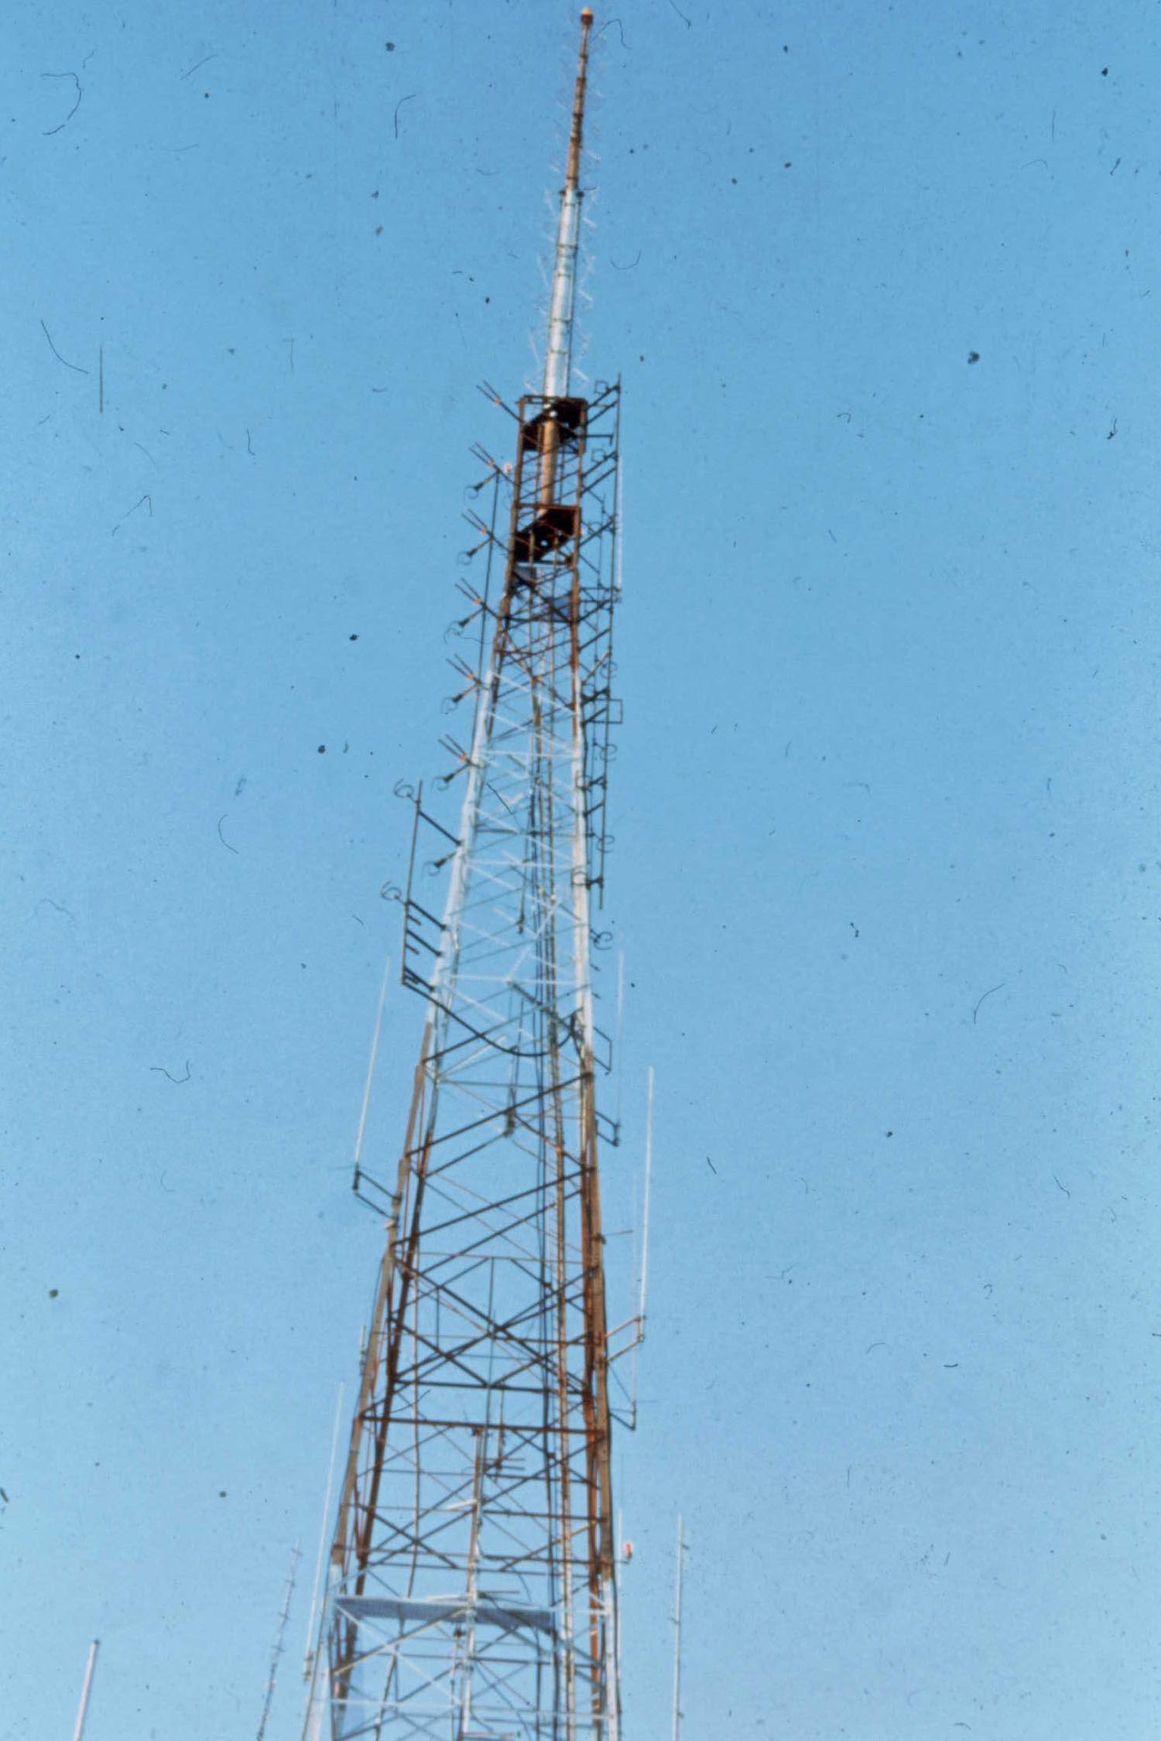
Cooperative RF Program for Shared Tower

Slide 106
Cooperative RF Program for Multiple Broadcasters

Slide 107
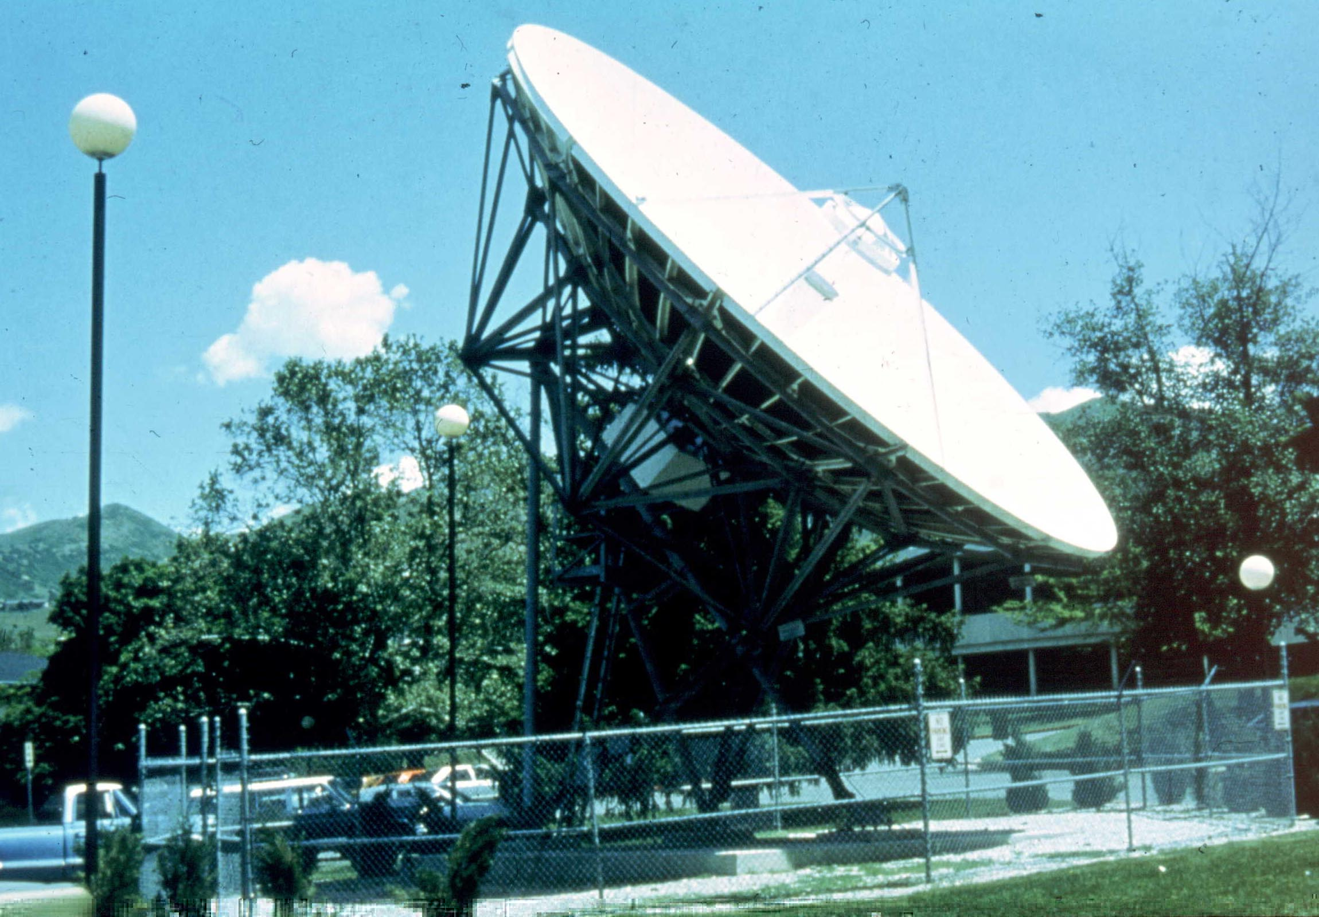
Fence to Limit Access

Slide 108
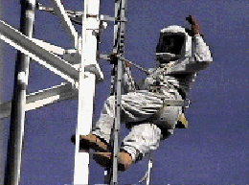
RF Protective Suits

Slide 109
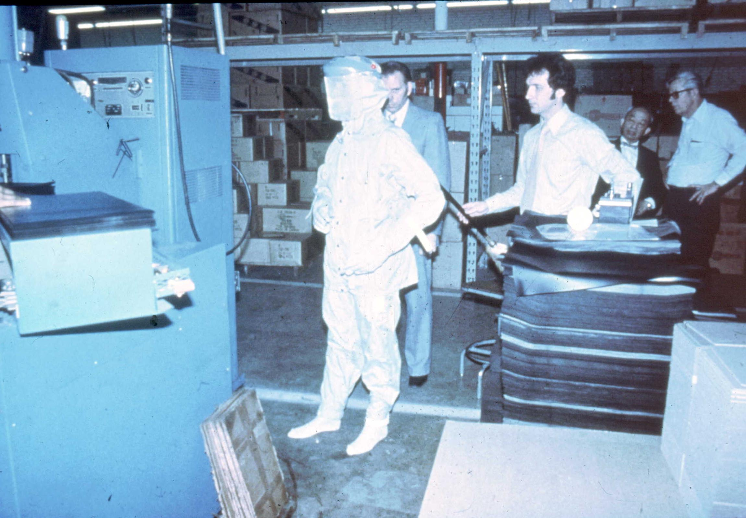
PPE Must Be Tested for Application

Slide 110
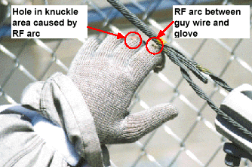
PPE Must Be Inspected & Maintained
From Ric Tell

Slide 111
Example Application of Signs Based on Exposure Category

Slide 112
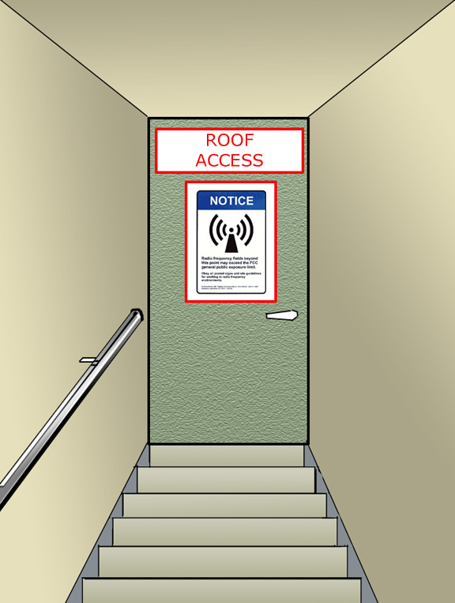
Sign at entrance to next exposure Category.

Slide 113
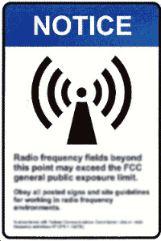
Notice for Public required by FCC.
Sign posted at boundary between Category I & II.

Slide 114
Optional
Notice of Worker-based RF Control Program.
Posted at access points into Category III.

Slide 115
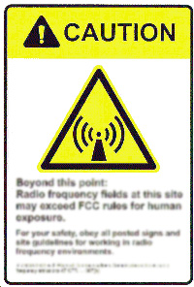
Caution workers to use Controls
Posted at access points into Category IV locations.

Slide 116
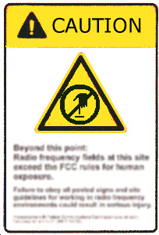
Alert to objects which may cause RF shock if contacted without PPE.

Slide 117
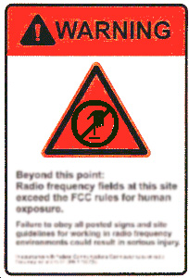
Alert to objects which will cause RF Burns if contacted without PPE

Slide 118
Posted to mark prohibited access into Category V without power-down or PPE.
Note: Wrong symbol.

Slide 119
Posted to mark prohibited access without power-down.
PPE is not sufficient.

Slide 120
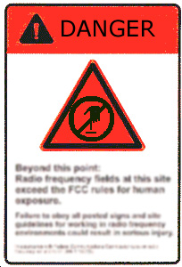
Alert to objects which will cause severe RF Burns if contacted.
PPE may not be sufficient.

Slide 121
RF Personal Protective Equipment
If PPE is utilized, a PPE Program must ensure its effectiveness, including proper:
Selection of RF PPE within tested capabilities.
Accessibility, Use, & Maintenance.

Slide 122
Training: What to Teach
Location of sources and potentially hazardous areas.
Health effects and safety standards.
Extent of exposures compared to standards and common sources.
Required SOP’s and controls.
Emergency procedures.
How to know when things are “abnormal”.
Optional controls employees may use.

Slide 123
Program Review
Adequacy of Program Design
Program Implementation
Interview employees
What are the hazards and controls?
What steps have been taken to enforce the rules?
Determine what to change, add, and delete.

Slide 124
Possible Non-Mandatory Appendices
Example RF Safety Program for a communications company which routinely services/installs antennas on rooftops.
Appendices concerning PPE and signage

Slide 125
Example Applications

Slide 126
Category I Locations
Most people, including workers, are in Category I locations.
Therefore, most locations do not need an RF Safety Program.

Slide 127

Computer Work Station

Slide 129
Exposure Locations
I
Outside the fence
II
Inside fence
III
On satellite dish
IV
Between emitter and focal point
V
Broken wave guide

Slide 130
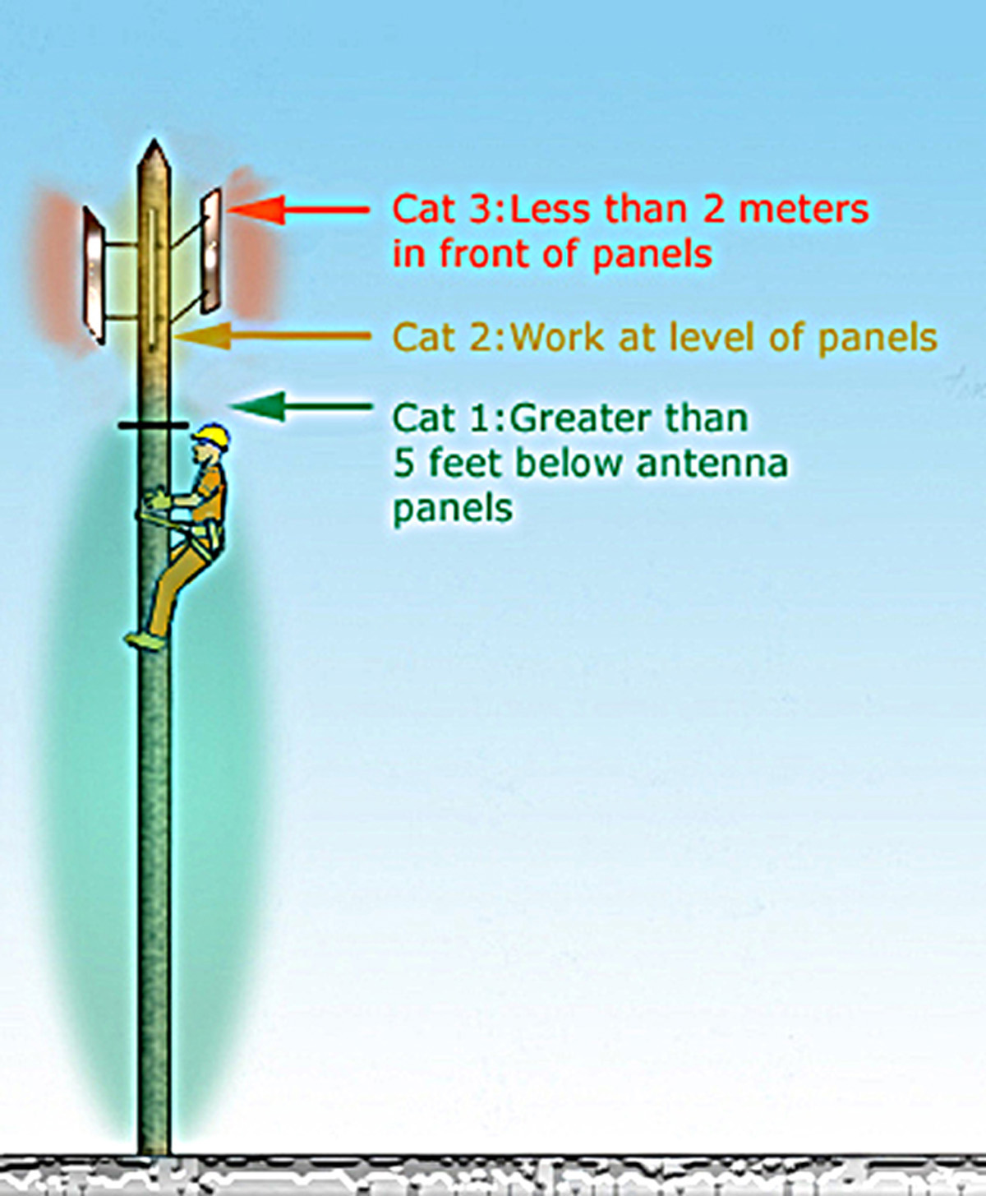
Cell Tower

Slide 131
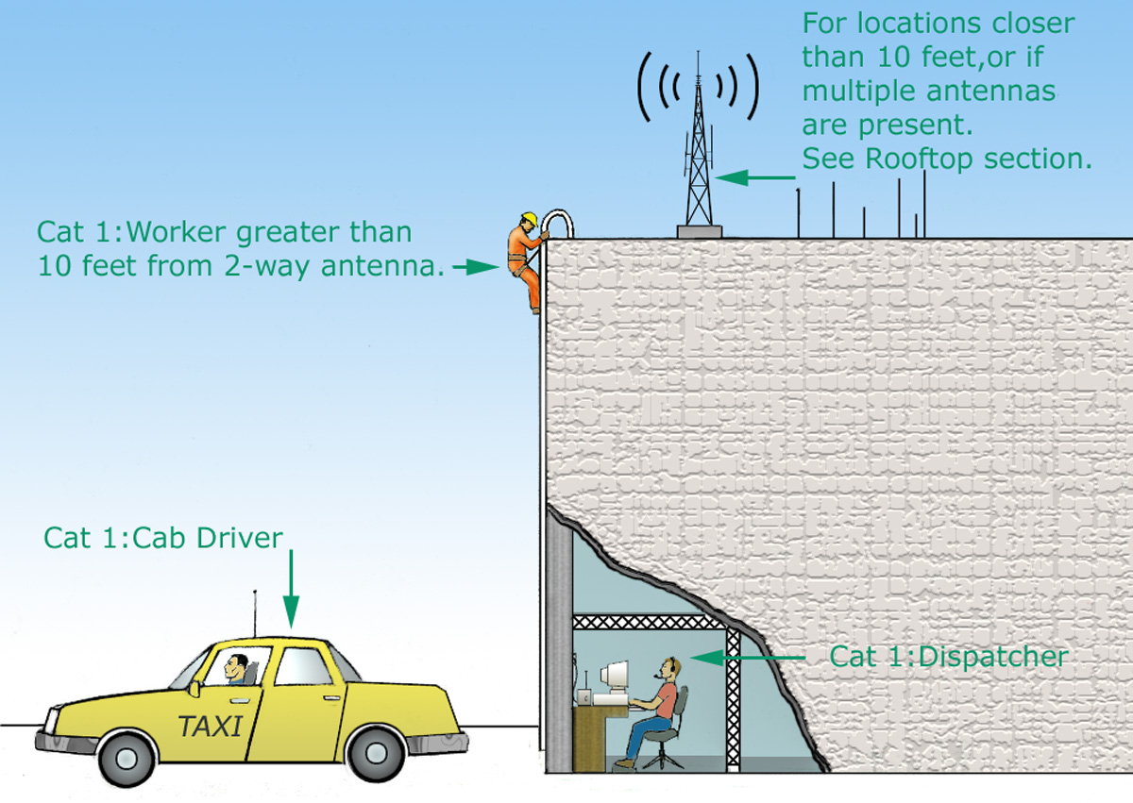
,

Slide 132
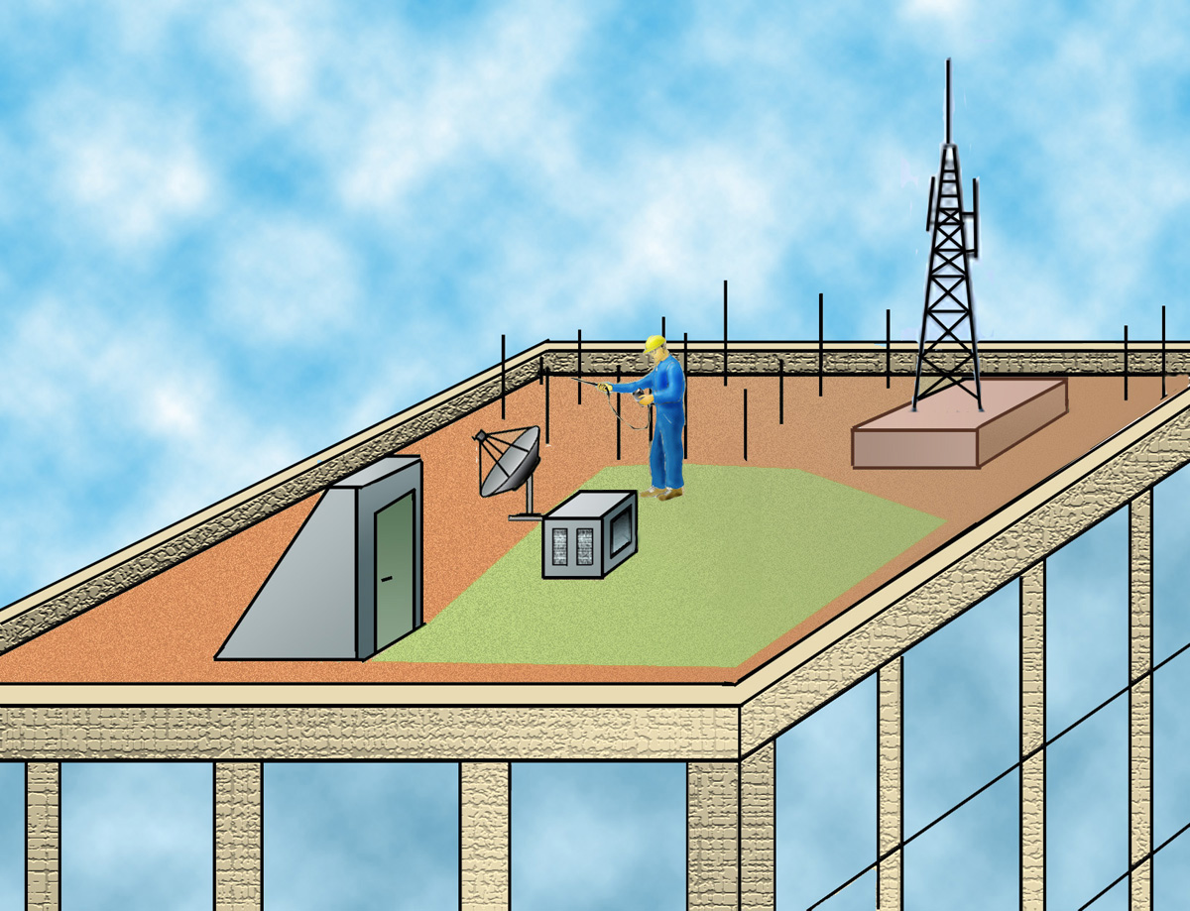

Slide 133
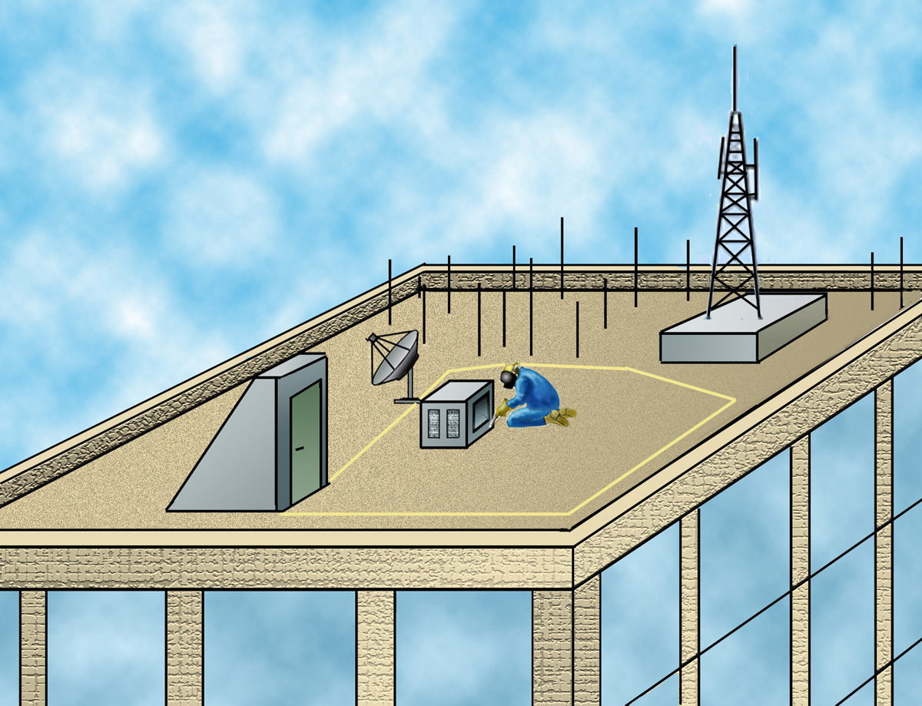

Slide 134


Slide 135
Safety and Health Program Core Elements
Management leadership and employee participation
Hazard identification and assessment
Hazard prevention and control
Information and training
Evaluation of program effectiveness

Slide 136
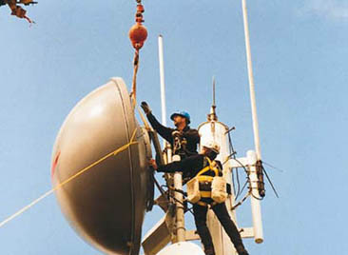
Exposure While Installing New Antenna

Slide 137
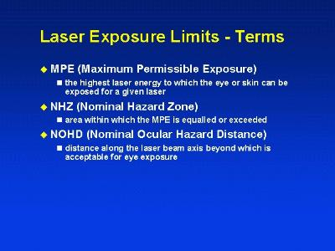
UIUC

Slide 138
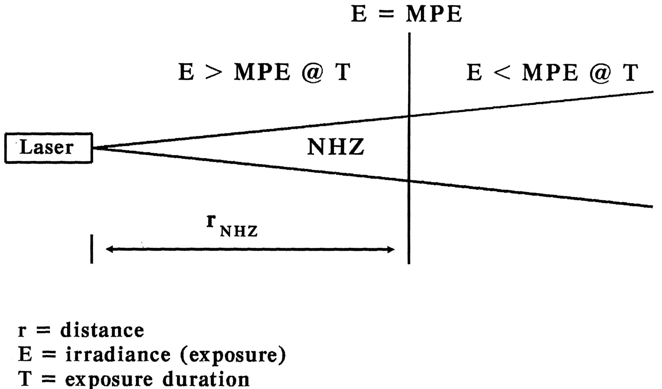
Nominal Hazard Zone

Slide 139


Slide 140


Slide 141


